Slide 1

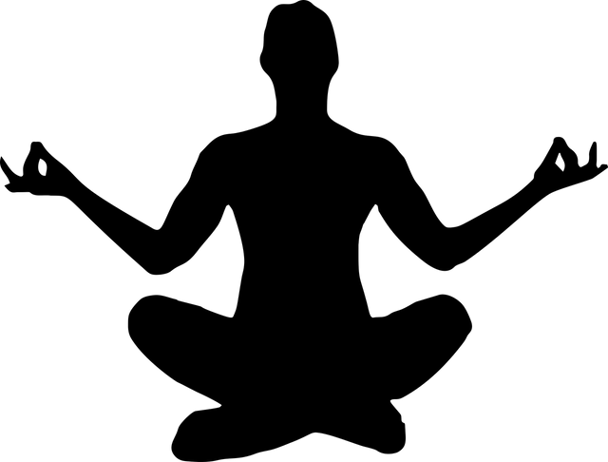
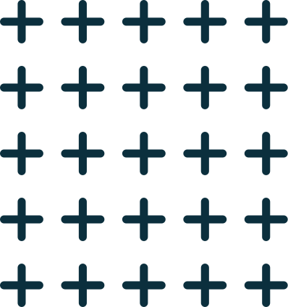
REAL TIME YOGA
POSE DETECTION
Sanskar Ghyar (200873)
Happy Pachori (200399)
Supervised by Dr. Tushar Sandhan
Department of Electrical Engineering
IIT Kanpur
Jan 2023 - Apr 2023

Slide 2

Introduction
Nowadays, yoga has gained worldwide attention because of increasing levels of stress in the modern way of life, and there are many ways or resources to learn yoga. In the modern world we suggest having a Tutor around while doing yoga. It does not always happen to have a Tutor or join yoga classes these days. So an AI-based program helps
in the estimation and identification of yoga poses.
Activity recognition is the process of continuously monitoring a person’s activity and movement. Human posture recognition can be utilized to assemble a self-guidance practice framework that permits individuals to accurately rehearse yoga postures without getting help from anyone else. With the use of deep learning algorithms, we propose an approach for the efficient detection and recognition of various yoga poses.

Slide 3
Timeline
Basic idea of the problem statement
Dataset collection
STAGE
I
Strong baseline of the problem statement
Trained different models
STAGE
II
Add angle feature vector
Modified keypoints feature vector
Realtime pose classifier
STAGE
III
Own
contribution :

Slide 4
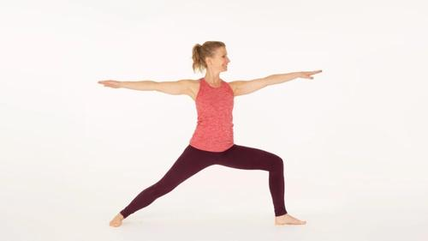
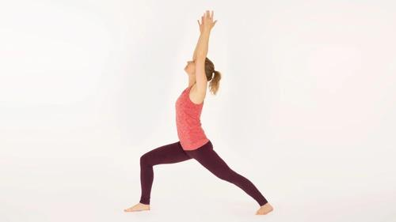
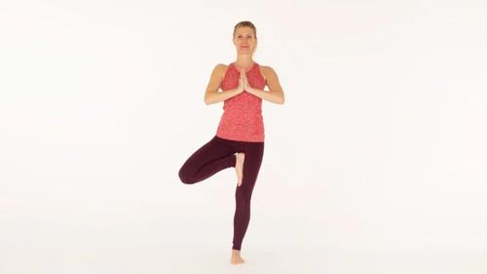
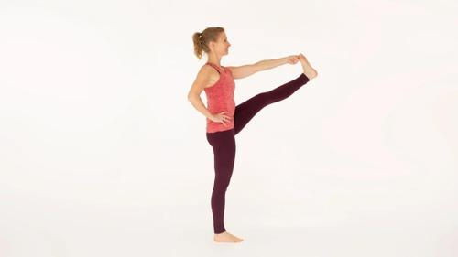
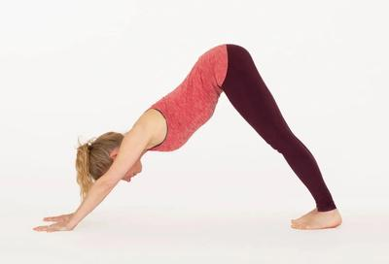
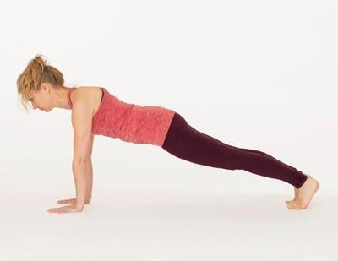
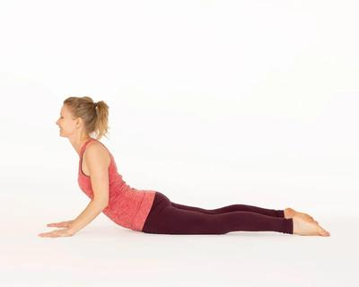
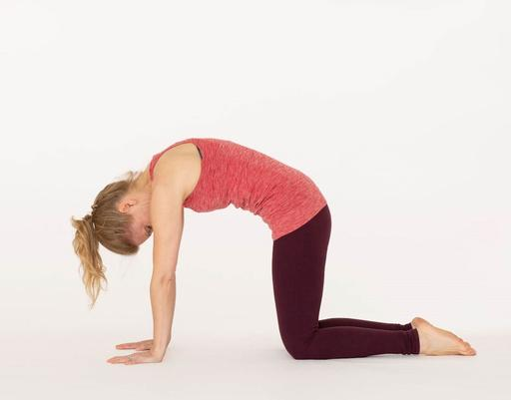
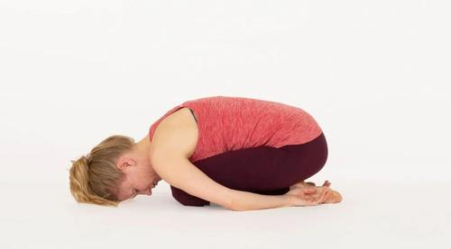
Dataset
Warrior II Warrior I Tree
Three different types of dataset were used from different sources:-
yoga_poses (Tensorflow) :
1500 images of 5 poses
Kaggle dataset : 1500 images of 5 poses
yoga_82 (Google) :
2100 images for 9 poses
The finally chosen dataset consists of 9 different poses chosen from the yoga_82 dataset.
Standing big toe Downward facing dog Plank
Cobra Cat & cow Child

Slide 5
Methodology
Extract key points :-
To extract key points of body skeletal for the pose, 2 models were used:-
MoveNet Thunder
Mediaipipe
Split dataset for training and testing
Preprocess data and create labels and features
Train classification models :-
We used 3 different types of model:-
Artificial Neural Networks (ANN)
Recurrent Neural Networks (RNN)
k-Nearest Neighbour (KNN)
After this we saved the weights of best model, made predictions based on our best model and evaluate using confusion matrix and accuracy.
Finally we test our model in real time.

Slide 6
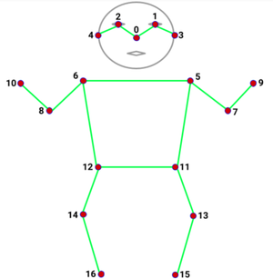
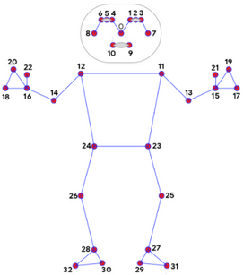
Key points extraction
In the context of yoga, key point extraction can be used to track the positions of key joints in the body during a yoga practice. Two different models were used to extract key points from the image of yoga pose: MoveNet Thunder and Mediapipe.
Movenet Thunder - It is a deep learning-based pose estimation model with very high accuracy which tracks 17 keypoints of body which consist x & y coordinates and corresponding confidence score for each keypoint
Mediapipe - It is similar model to Movenet but with a very low computational cost. It track 33 keypoints which consist x, y & z coordinates and corresponding confidence score for each keypoint

Slide 7
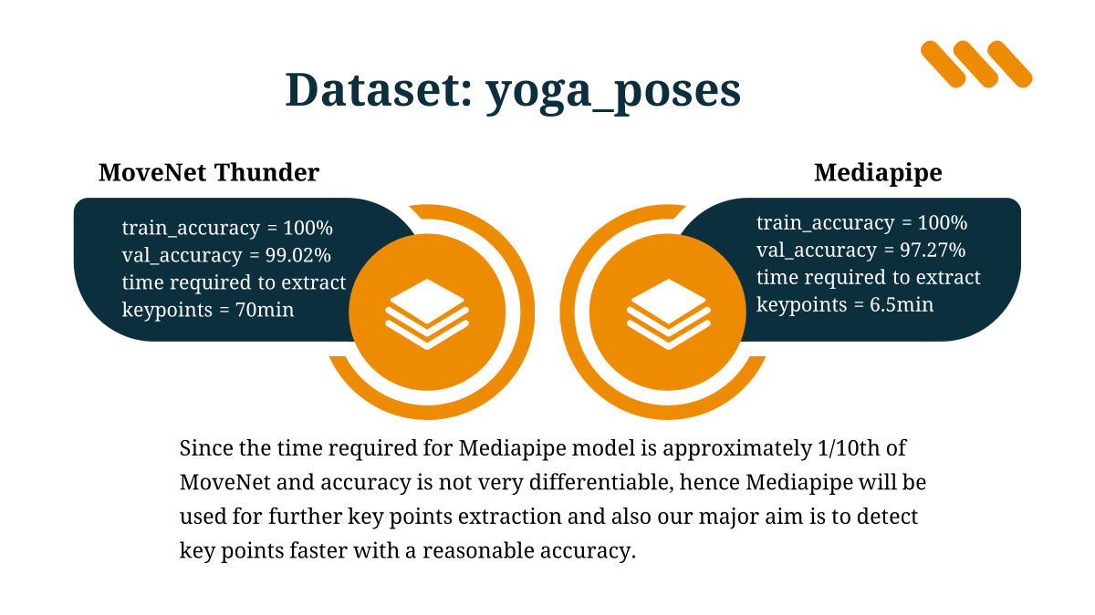

Dataset: yoga_poses
MoveNet Thunder
Mediapipe
train_accuracy = 100%
val_accuracy = 99.02%
time required to extract
keypoints = 70min
train_accuracy = 100%
val_accuracy = 97.27%
time required to extract keypoints = 6.5min
Since the time required for Mediapipe model is approximately 1/10th of MoveNet and accuracy is not very differentiable, hence Mediapipe will be used for further key points extraction and also our major aim is to detect key points faster with a reasonable accuracy.

Slide 8
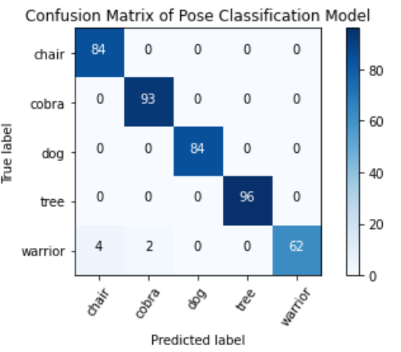
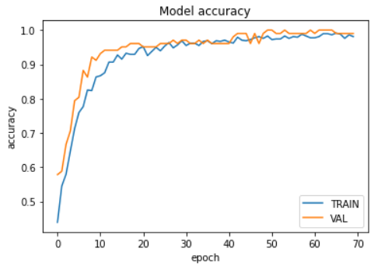

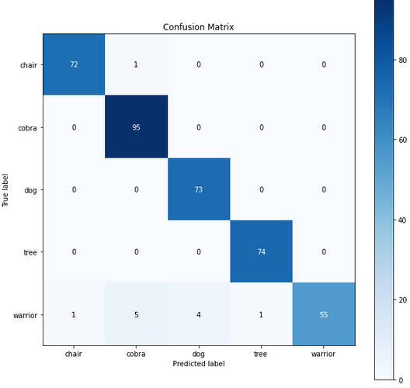
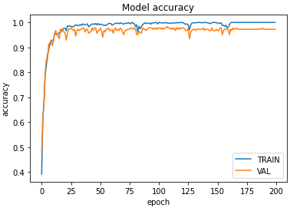
Results from which we concluded our choice for best model to detect key points
MoveNet Thunder
Mediapipe
Keypoints of Mediapipe:

Slide 9
Preprocess Data and create labels and features
Dataset was cleaned for the images having more than one person and doodle images
After extraction of various key points from the images and adding label according to various poses we compile our results into a single .csv file. Then dataset was split in ratio of 4:1 for training and testing respectively for each individual classes so that dataset is equally split for each label.
Types of feature vectors -
33 key points (x, y & score of each key points)
Angles of main joints
Reduced key points
Angle of main joints + key points
Relative and normalised keypoints

Slide 10
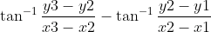
Feature vector
Reduced keypoints(23):-
Nose is the only important keypoint in face, hence other keypoints were dropped.
8 angles of main joints:-
Left & right elbow angle, left & right shoulder angle, left & right hip angle and left & right knee angle
Angle of joints =
Relative & Normalised feature vector:-
Pose centre of body was considered as midpoint of hip:-
pose_centre = 0.5*(left_hip+right_hip)
Then relative position was taken for each keypoints:-
relative_keypoints = keypoints - pose_centre
normalised_relative_keypoints = relative_keypoints / distance from pose_centre
Both 8 angle of main joints and relative & Normalized feature vector are independent of the distance of body from camera.

Slide 11
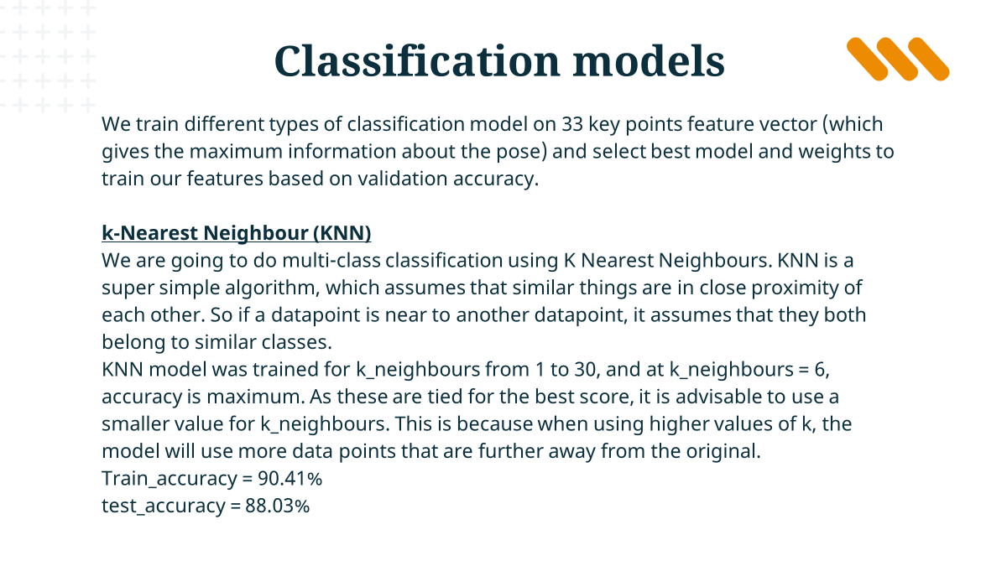
Classification models
We train different types of classification model on 33 key points feature vector (which gives the maximum information about the pose) and select best model and weights to train our features based on validation accuracy.
k-Nearest Neighbour (KNN)
We are going to do multi-class classification using K Nearest Neighbours. KNN is a super simple algorithm, which assumes that similar things are in close proximity of each other. So if a datapoint is near to another datapoint, it assumes that they both belong to similar classes.
KNN model was trained for k_neighbours from 1 to 30, and at k_neighbours = 6, accuracy is maximum. As these are tied for the best score, it is advisable to use a smaller value for k_neighbours. This is because when using higher values of k, the model will use more data points that are further away from the original.
Train_accuracy = 90.4

Slide 12
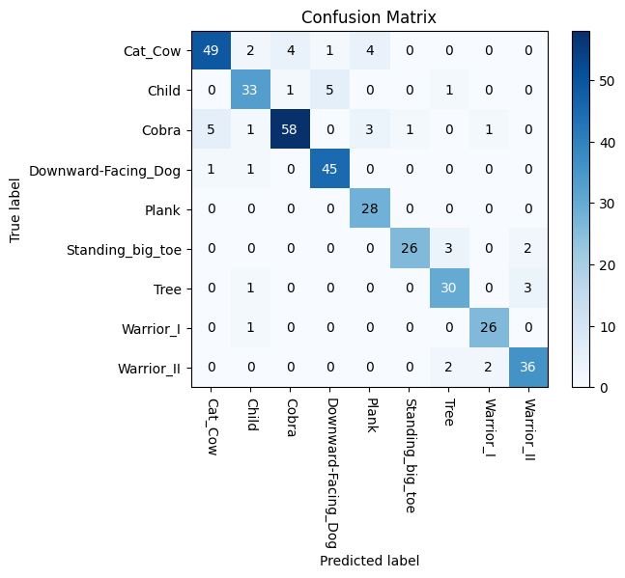
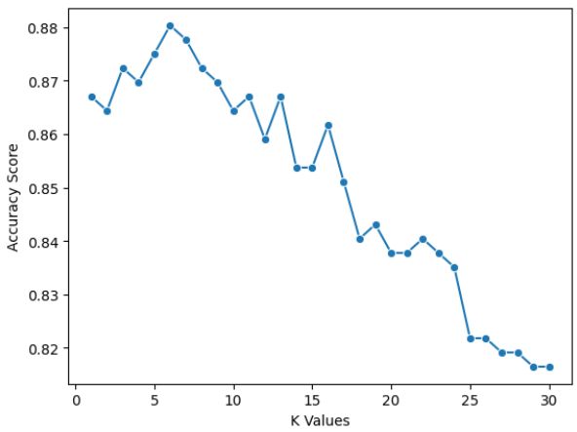
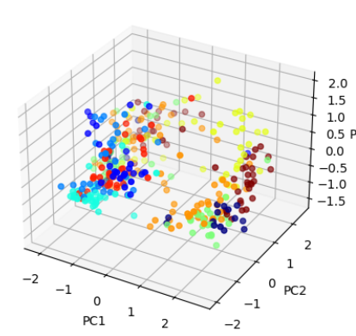
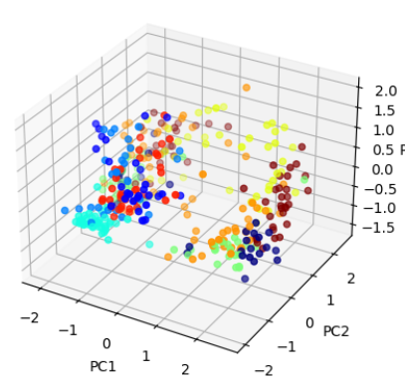
KNN
Accuracy score of KNN for different number of nearest neighbourt
Original clusters
Predicted clusters

Slide 13
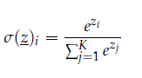
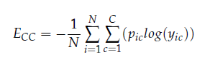
ANN
Input layer for ANN model in flatten array of size 99 (x,y and score each for 33 keypoints)
The activation function used in this layer is ReLU, which is a piece-wise linear function that gives an output
equal to 0 when the input provided is less than 0, else it gives as output the given input [31,32].
The activation function of ReLU:
ReLU(x) = max(0, x) ; where
The final layer used is a Dense layer that uses Softmax as the activation function,
which assigns probabilities of different poses based on the
current given input. The mathematical equation of
Softmax activation function is presented in Equation.
The Adam optimizer is employed; this optimizer
helps the model to fast converge by the addition of
momentum term and scaling term.
The loss function used is categorical cross-entropy which is
very popular for multiclass classification tasks. Equation
depicts the mathematical equation used in categorical
cross-entropy loss function.
Layer (type) | Output Shape | Params
dense (Dense) | (None, 128) | 12800
dense_1 (Dense) | (None, 256) | 33024
dense_2 (Dense) | (None, 64) | 16448
dense_3 (Dense) | (None, 9) | 585
Total params = 62857 | Trainable params = 62857 | Non trainable params = 0

Slide 14
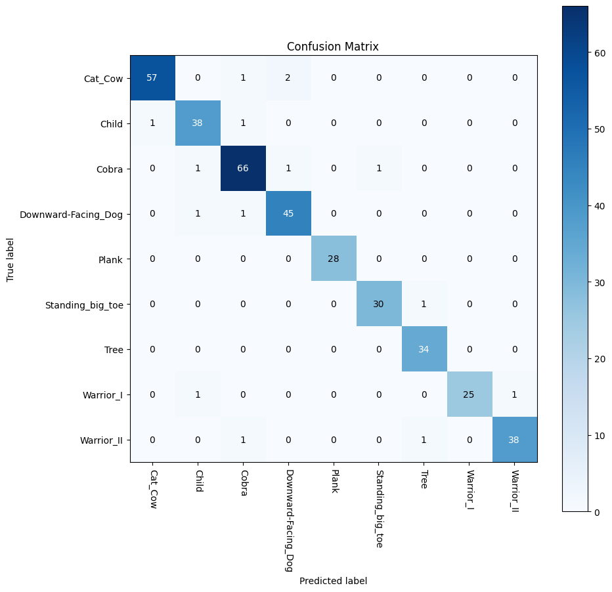
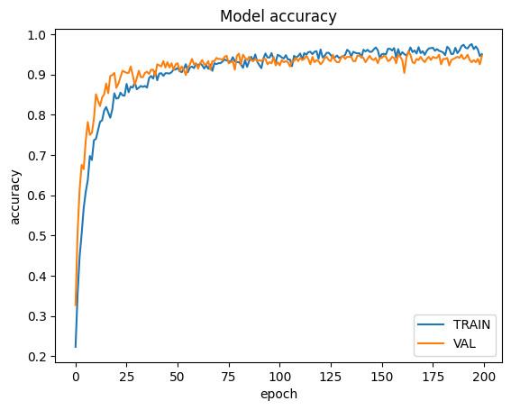
ANN
train_accuracy = 98.9%
val_accuracy = 95.7%

Slide 15
RNN
Input layer for RNN model is array of size (1,99) (x, y and score each for 33 keypoints)
Long Short-Term Memory (LSTM) unit is the portion that does the remembering.
The activation function used in this layer is ReLU, which is a piece-wise linear function that gives an output
equal to 0 when the input provided is less than 0, else it gives as output the given input [31,32].
The activation function of ReLU:
ReLU(x) = max(0, x) ; where
The final layer used is a Dense layer that uses Softmax
as the activation function, which assigns probabilities
of different poses based on the current given input.
The mathematical equation of Softmax activation
function is presented in Equation.
The Adam optimizer is employed; this optimizer
helps the model to fast converge by the addition of
momentum term and scaling term.
The loss function used is categorical cross-entropy which is
very popular for multiclass classification tasks. Equation
depicts the mathematical equation used in categorical
cross-entropy loss function.
Layer (type) | Output Shape | Params
lstm (LSTM) | (None, 1, 128) | 116736
lstm_1 (LSTM) | (None, 256) | 394240
dense (Dense) | (None, 64) | 16448
dense_1 (Dense) | (None, 9) | 585
Total params = 528009 | Trainable params = 528009 | Non trainable params = 0

Slide 16

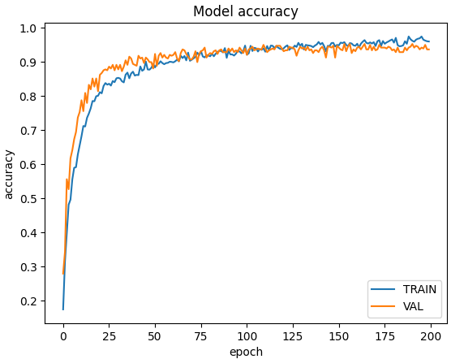
RNN
train_accuracy = 98.53%
val_accuracy = 93.62%

Slide 17


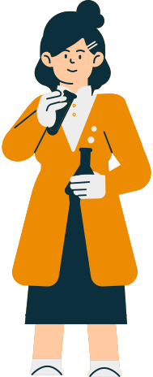
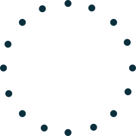
Best Model
We used three different types of model for our problem: KNN, ANN and RNN.
Out of these three model ANN performs best in terms of accuracy with which it classifies the different classes.
KNN model has some limitation and performs best according to the limitations with which it can classify.
Our ANN and RNN model are exactly the same having one different layer in RNN which is LSTM layer, now adding this layer actually decreases our accuracy because LSTM layer is used to learns long-term dependencies between time steps in time series and sequence data. Here our poses used are independent of other poses. No pose is in the sequence to reach the other pose all poses are individual poses. So using LSTM layer or RNN model is going to be of no benefit and it will increase the complexity of the model hence reducing the accuracy.
So the model we are going to use for best results from different feature vector is ANN.

Slide 18
Results obtained on training ANN on different feature vectors
Feature vectors used | test_accuracy | f1_score | precision | recall
33 keypoints | 95.74 | 95.75 | 95.90 | 95.74
Angles | 92.28 | 92.38 | 92.74 | 92.28
Reduced (23) keypoints | 93.88 | 93.84 | 94.06 | 93.88
Angles + 33 keypoints | 92.02 | 92.13 | 92.49 | 92.02
33 Normalised keypoints | 94.14 | 94.14 | 94.2 | 94.14

Slide 19
Conclusion based on results obtained
Conclusion about feature vectors
33 Keypoints feature vector and normalized & Relative feature vector almost give the same result. This means that mediapipe model is extracting keypoints from the given dataset quiet effectively and normalizing, finding relative position of keypoints will not provide much of a difference in the results.
Angle of major joints feature vector shows less accuracy because if the mediapipe model is not able to extract information about let's say one point correctly then the definition of the pose according to angle will change abruptly and hence classify our poses incorrectly.
Angle +Keypoints feature vector confuses the model about the definition of pose according to angle which we discussed above and according to keypoints because of this reason the accuracy decreases.
Reduced keypoint feature vector is showing less accuracy because reducing keypoints is simply reducing the information about a certain pose.

Slide 20
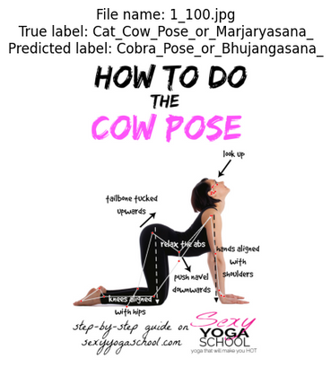
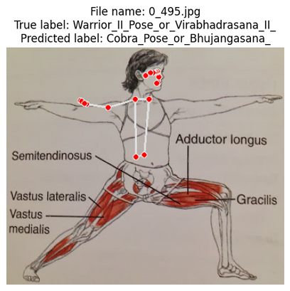
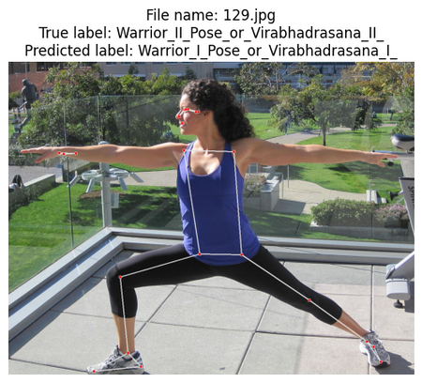
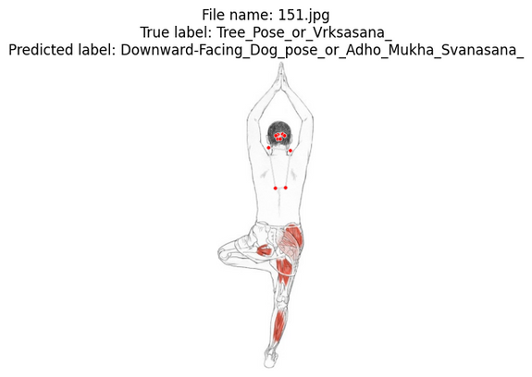
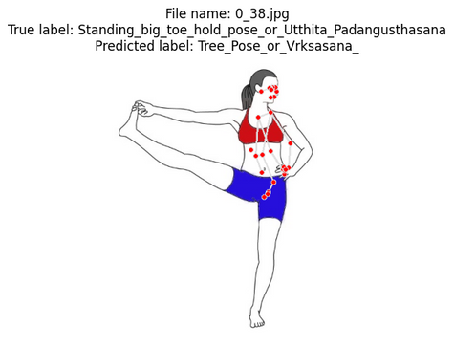
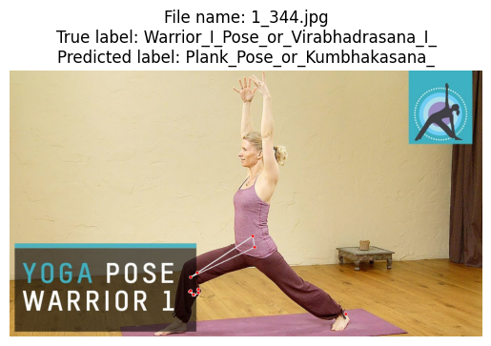
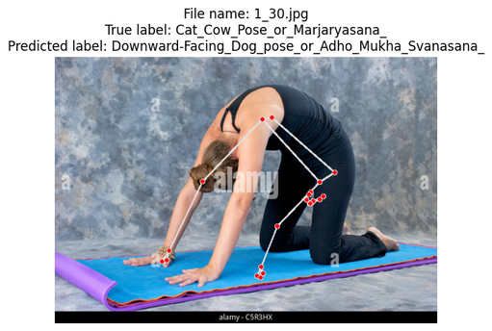
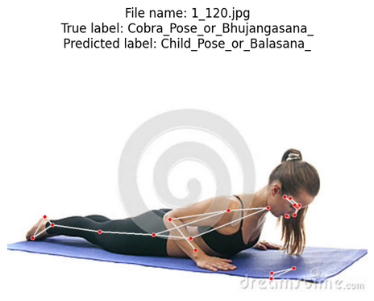
Wrongly classified images

Slide 21
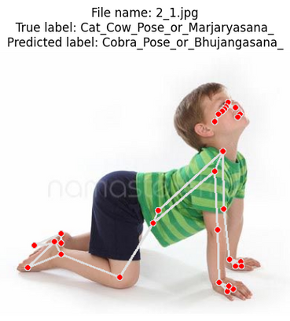
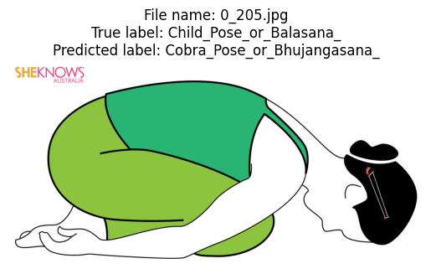
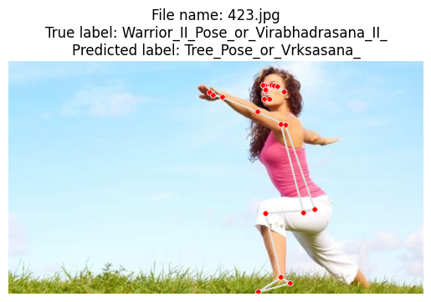
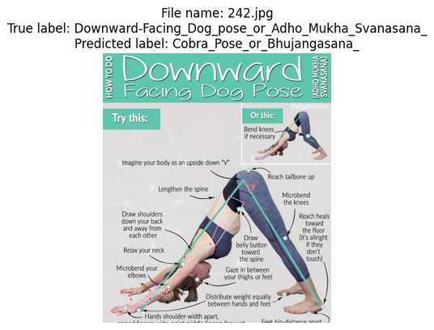
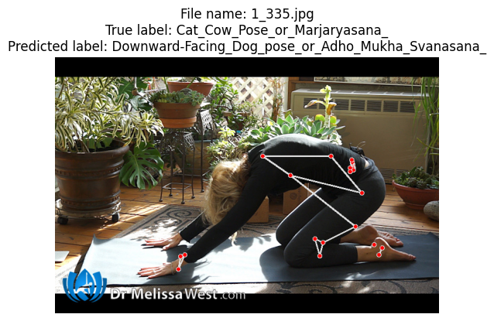
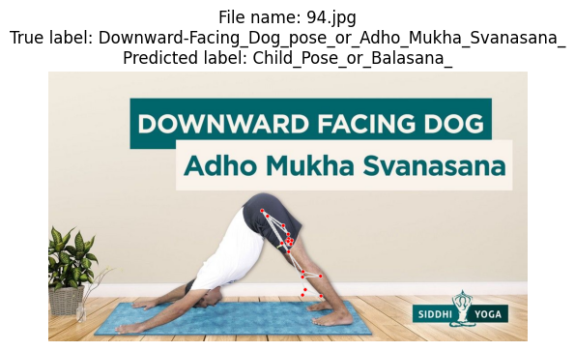
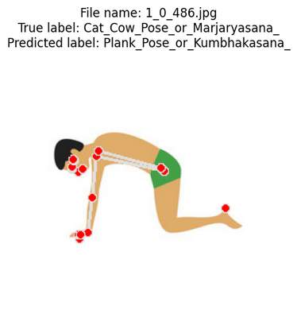
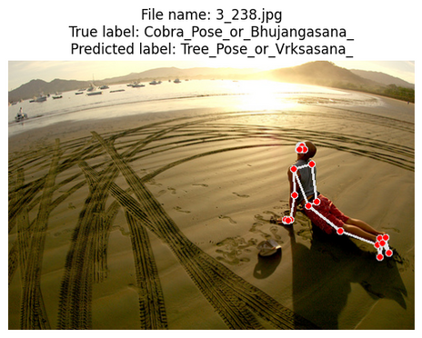
Wrongly classified images

Slide 22
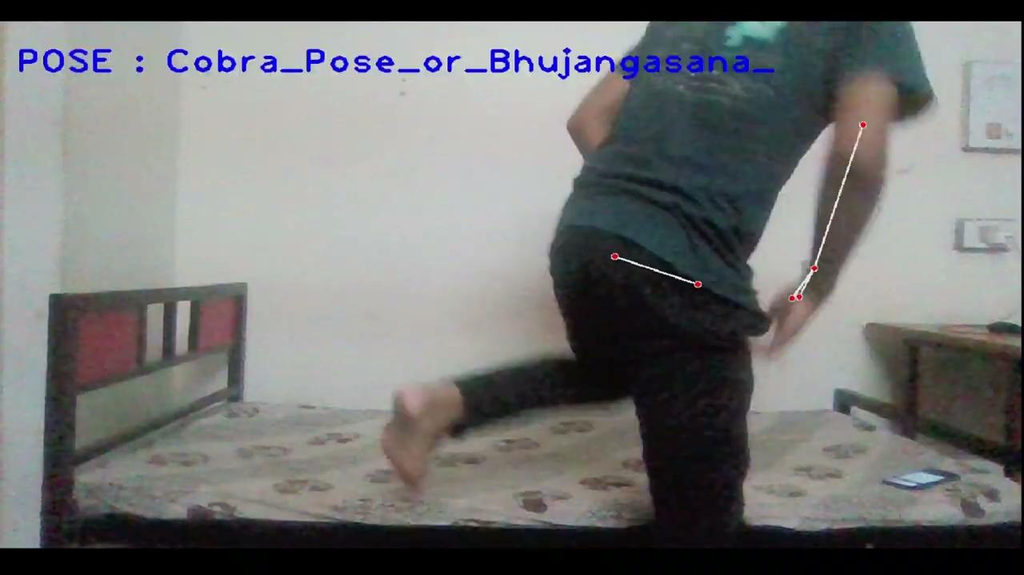
Real time estimation of yoga poses

Slide 23
Final Conclusion and Future Development
Many studies on posture estimation in humans have been conducted in recent years. Estimating human posture requires localising and constructing human body parts based on a known human body structure, which is different from other computer vision tasks. By including posture assessment in the process, exercises can be made safer and more effective. We contend that yoga can be made more generally accepted while also ensuring that it is practised correctly through a self-learning approach. Deep learning approaches are interesting because of all the excellent research being done in this field. On the basis of Mediapipe data, all nine yoga poses were classified using ANN and LSTM models, in this ANN is seen to be a very successful method. It is also possible to use SVMs, but SVMs do not work with large datasets. This is less efficient than the models we used in this project. Therefore, this project will help people to perform yoga posture accurately and effectively by tracking and estimating the pose they are doing.

Slide 24


THANKS
FOR YOUR ATTENTION

